Slide 1
Supervised Learning 1
Rayid Ghani
Slides liberally borrowed and customized from lots of excellent online sources

Slide 2
Recap from last class: ML Process
Understand “Business” problem
Map to Machine Learning problem
Get (and integrate) the data
Explore and Process the data
Create “Features”
Select which methods to test
Evaluate methods
Deploy, Maintain, Update

Slide 3
Types of Learning
Unsupervised
Clustering
PCA
…
Supervised
Classification
Regression
…
“Weakly” supervised

Slide 4
Unsupervised Learning
No outcome or dependent variable is present
Goal is exploration, understanding historical data, finding patterns and/or groups in the data
Examples
Clustering (cluster analysis)
Principal Components Analysis
Association Rules (beer and diapers)

Slide 5
Supervised learning framework
y
= f( )
X
output
“Learned”
function
Features/Predictors
future/generalization
Training or Learning: Find an f that minimizes error in recovering y
Slide credit: L. Lazebnik

Slide 6
Supervised learning framework
y
= f( )
X
output
“Learned”
function
Features/variables/inputs/predictors/independent variables
Training: Given a training set of labeled examples {(x₁,y₁), …, (x_{N},y_{N})}, estimate the prediction function f that minimizes future generalization (out of sample) error
Scoring/Testing: apply f to a new example x and output the predicted value y = f(x)

Slide 7
How to solve a supervised learning problem
Define and Create label (outcome variable)
Define and Create Features (predictors)
Create Training and Validation Sets
Train model(s) on Training Set
Validate model(s) on Validation Set

Slide 8
Modeling/Learning Steps
Training
Training Labels
Features
Training
Learned model
Training Data
Testing
Features
Learned model
Prediction
Test Data

Slide 9
Methods
Nearest neighbor
Decision Trees
Logistic Regression
Support Vector Machines
Bayes Classifier
Ensembles
Bagging
Boosting
Random Forests
Neural Networks
We’ll cover these two in class today

Slide 10
Things you want to know about a method
What assumptions does it make about the data?
What is it optimizing for?
How to train it?
What parameters does it have?
How to select those parameters?
How to use it to score new data?
How to interpret the model and the predictions?

Slide 11
Some dimensions to compare supervised learning methods
Efficiency
Training
Scoring
Robustness to noise in the data
Robustness to violations of assumptions

Slide 12
Simplest classifier

Slide 13
Classifiers: Nearest neighbor
Test example
Training examples from class 2
Training examples from class 1
f(x) = label of the training example nearest to x
All we need is a distance function for our inputs
No training required!
Slide credit: L. Lazebnik

Slide 14
K-nearest neighbor
x
x
x
o
x
x
x
+
o
o
x
x
o
o
+
o
o
x2
x1

Slide 15
1-nearest neighbor
x
x
x
o
x
x
x
+
o
o
x
x
o
o
+
o
o
x2
x1

Slide 16
3-nearest neighbor
x
x
x
o
x
x
x
+
o
o
x
x
o
o
+
o
o
x2
x1

Slide 17
5-nearest neighbor
x
x
x
o
x
x
x
+
o
o
x
x
o
o
+
o
o
x2
x1

Slide 18
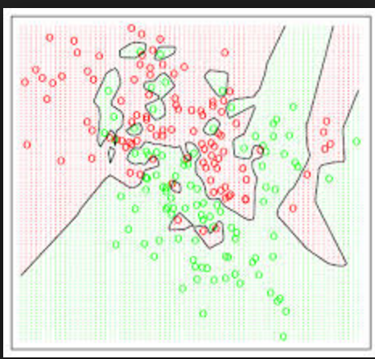
Voronoi Diagrams
Given a set of points, a Voronoi diagram describes the areas that are nearest to any given point.

Slide 19
K-NN: Benefits
Simple to use
Fast to train
With infinite examples, 1-NN provably has error that is at most twice ‘optimal’ error

Slide 20
When would kNN not work?

Slide 21
K-NN: Problems
Need to figure out the right distance function
Slow at scoring/prediction time
Need to store all the data
Extra variables can hurt

Slide 22
Classifiers: Decision Trees

Slide 23
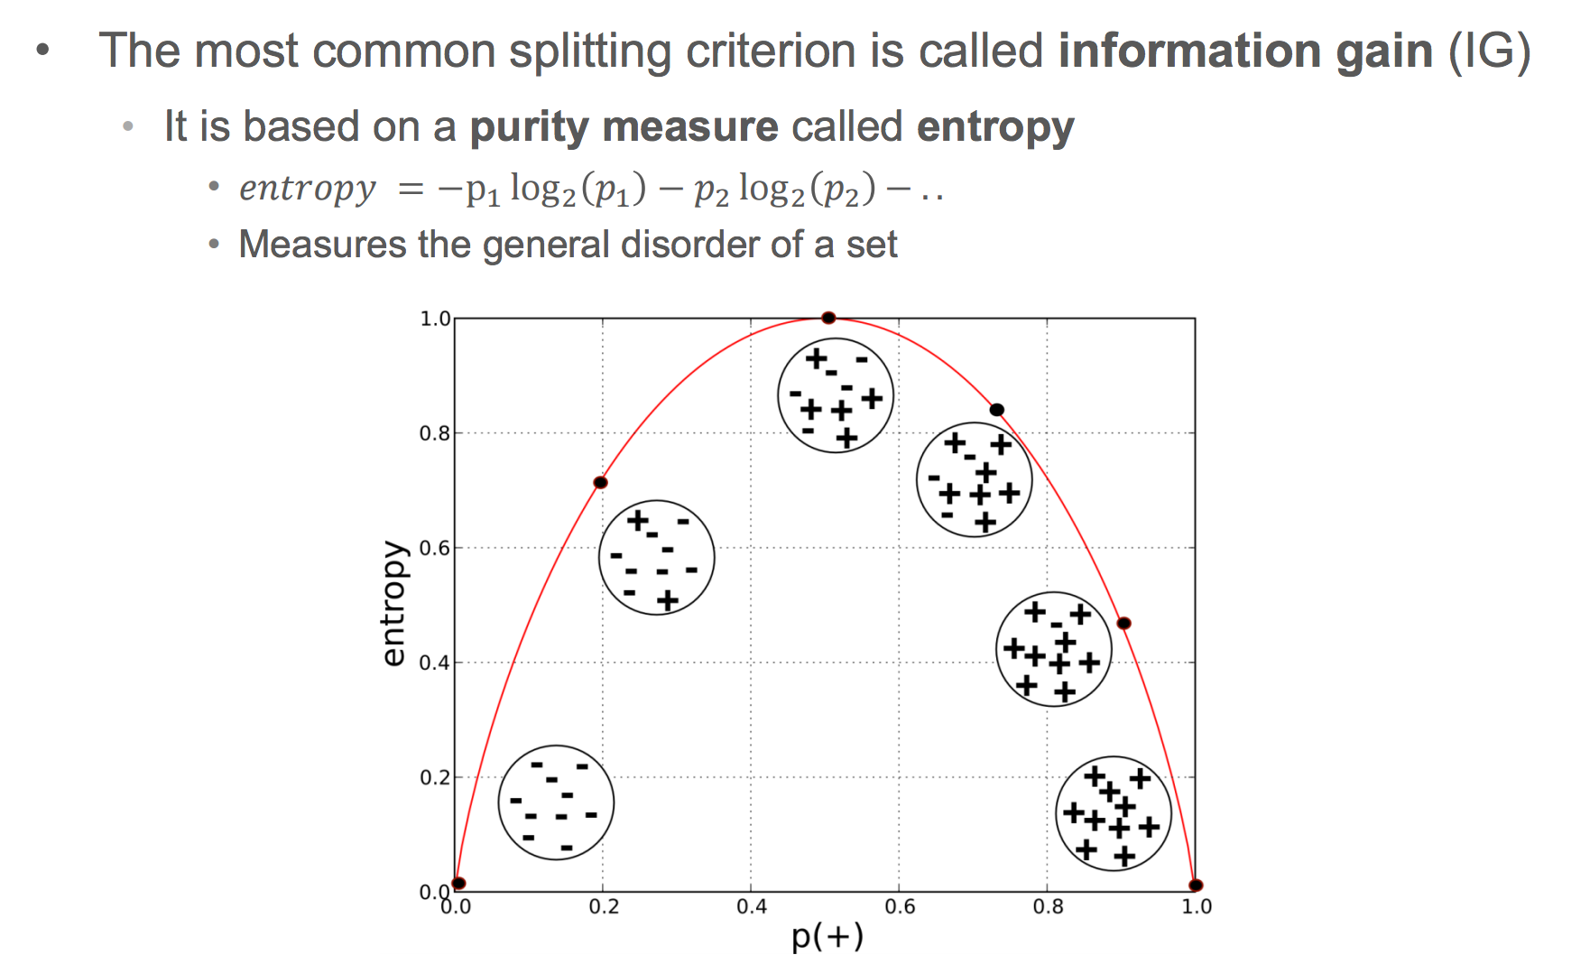
Information Gain

Slide 24
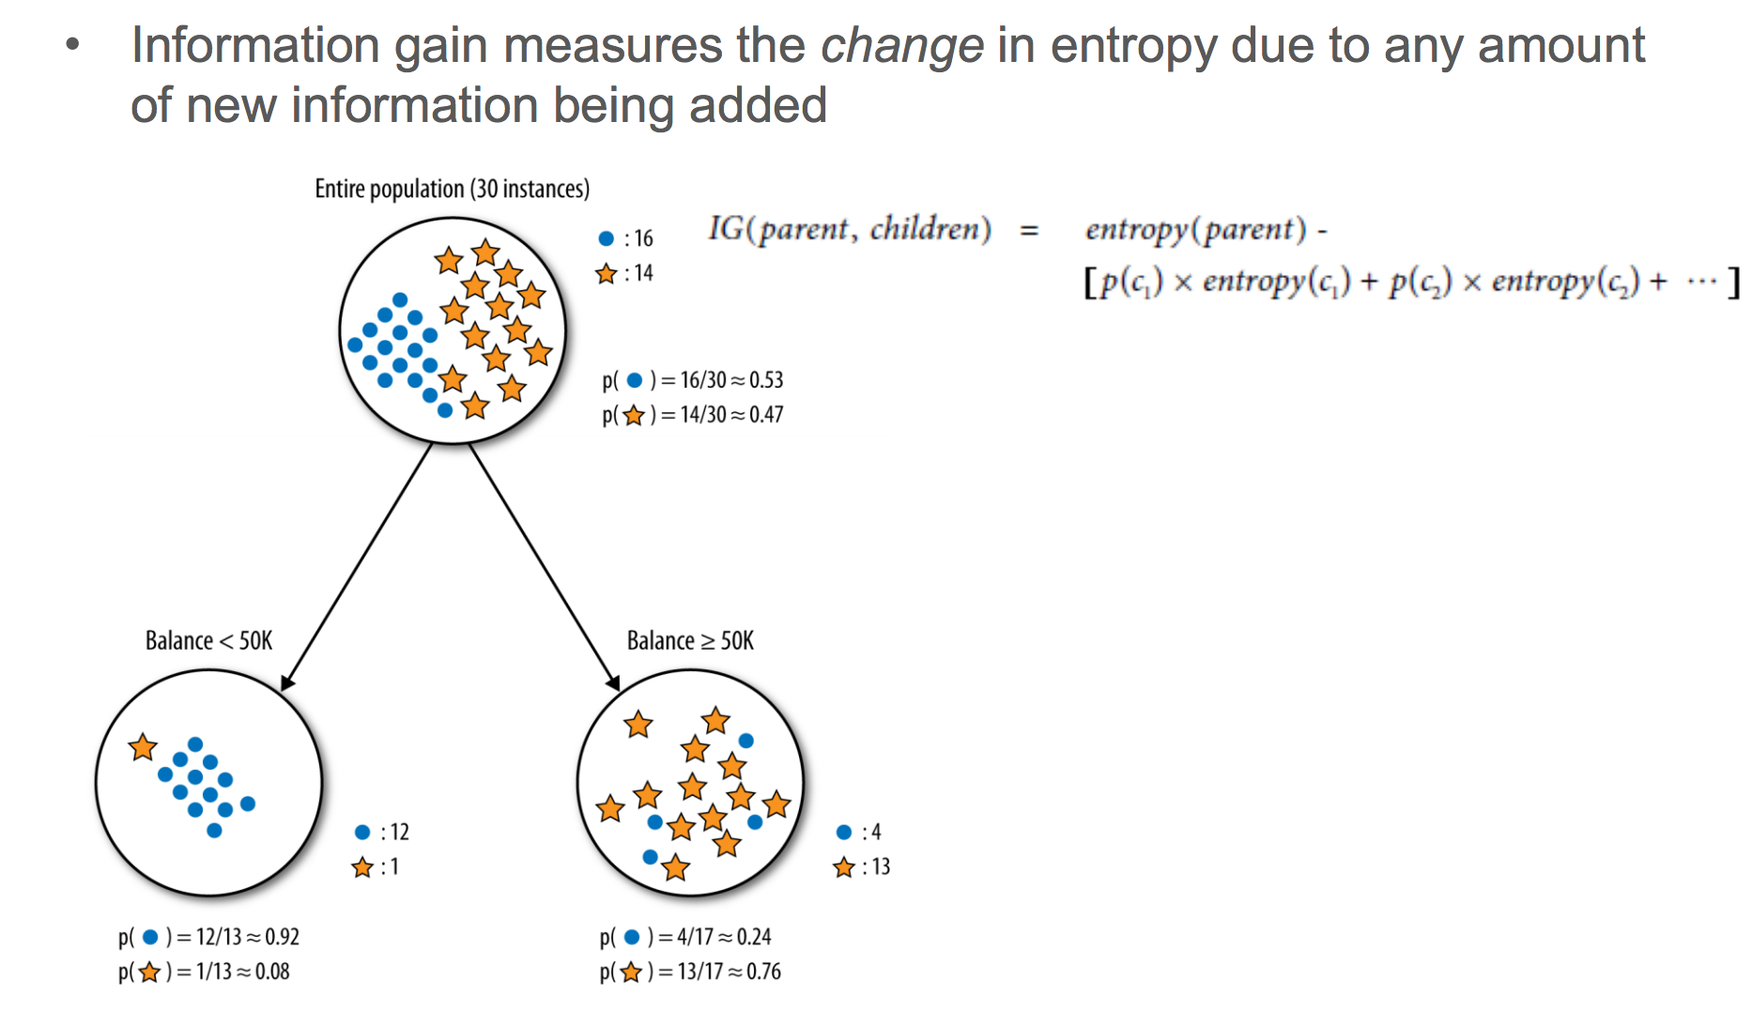
Information Gain

Slide 25
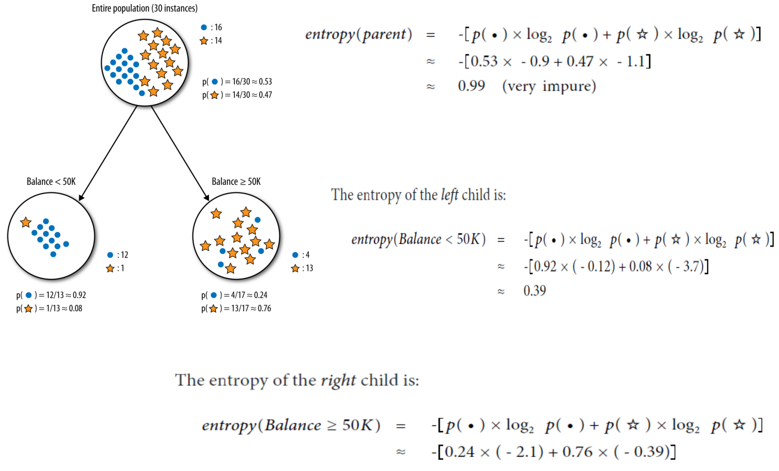

Slide 26
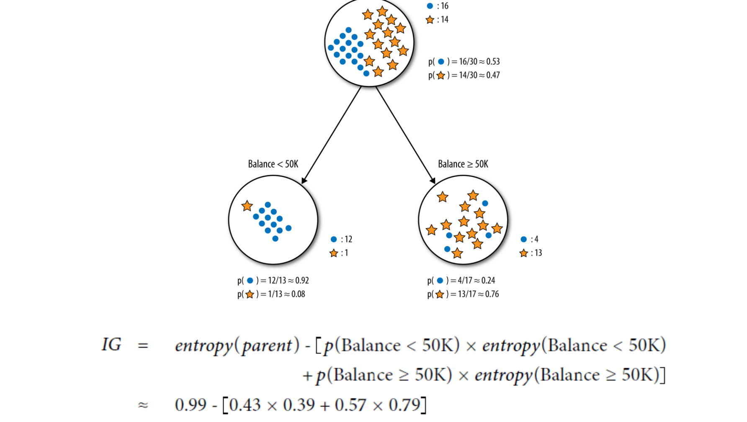

Slide 27
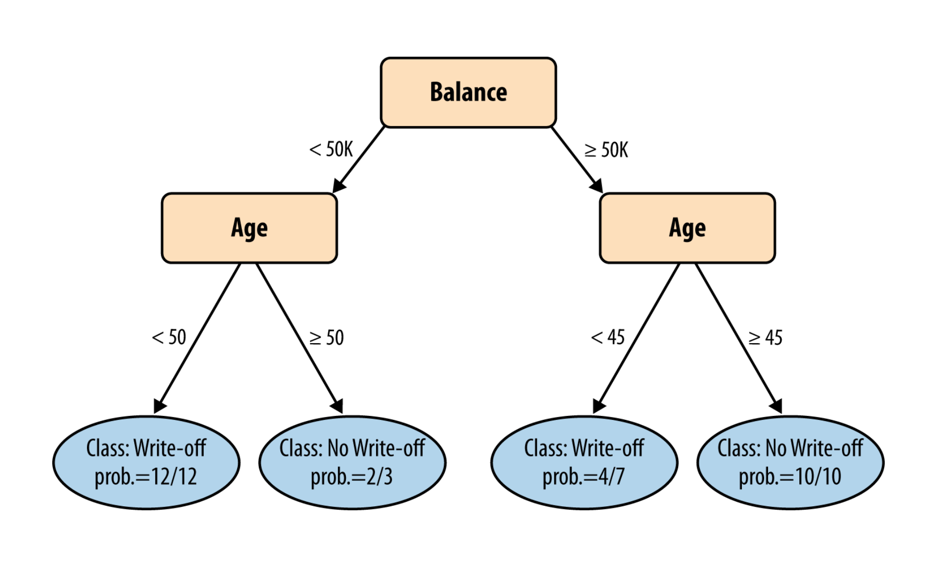

Slide 28
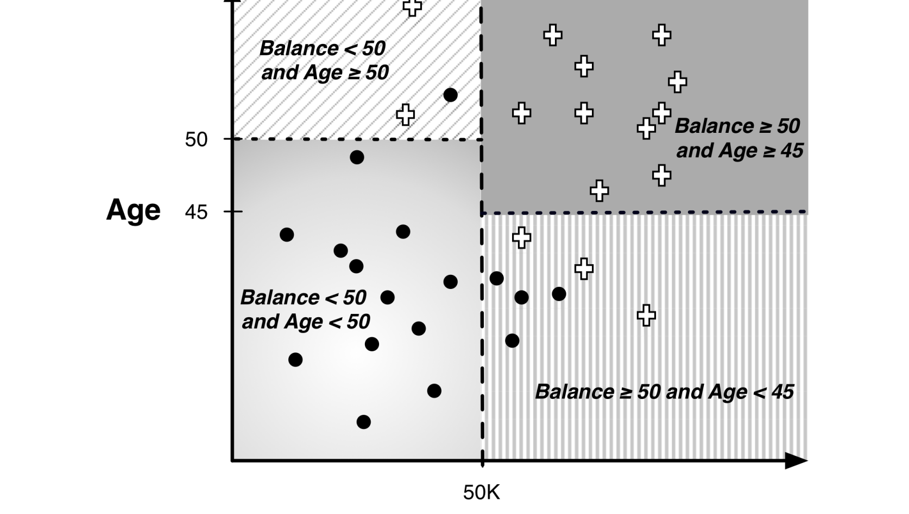

Slide 29
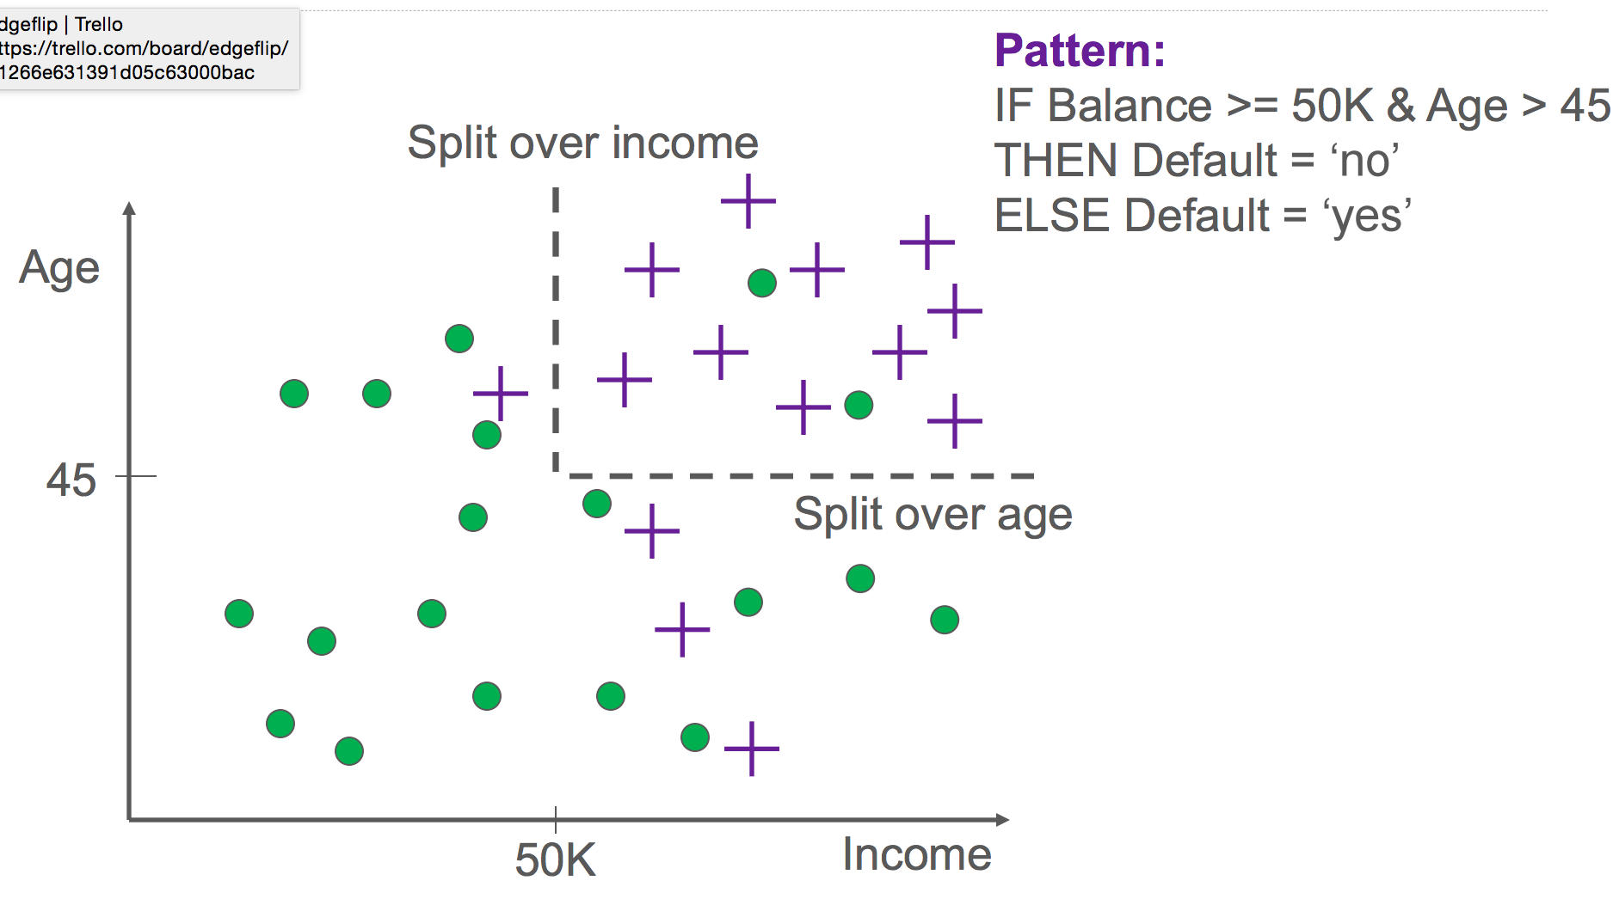

Slide 30
Pruning and Stopping Criteria
Minimum # of samples for splitting

Slide 31
Decision Trees: Pros and Cons
Pros
Possibly easy to understand (if small)
Cons
Unstable: Sensitive to small changes in data
(usually) Not very accurate

Slide 32
Questions to think about
When would decision trees not work well?
How would you do regression using a tree?
Is any special data prep required for trees?

